Slide 1
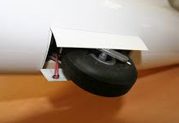
Glider
Landing Gear
Warning Systems
Explanations, Guidance, and Animation
Updated: September 29, 2025

Slide 2
Please Note #1
This presentation may have been updated with new information, changes, and/or corrections.
Be sure to visit my presentation web site and download the latest version of this document. It could make an important difference to your work!
http://aviation.derosaweb.net/presentations
Thank you, John (OHM Ω)

Slide 3
Please Note #2
There is no single universal answer on how
to implement a landing gear warning system in a particular glider. This is due to gliders having many different linkage designs to raise/lower landing gear and to open/close airbrakes. Hopefully, this presentation will provide enough information and pointers to help you design, install, and test a landing gear warning system for your glider.

Slide 4
Table of Contents
Learning How Gear Warning Works
Gear Warning Animation
Hardware Devices
Implementation
Testing the System

Slide 5
LEARNING HOW A
LANDING GEAR
WARNING SYSTEM WORKS

Slide 6

Learning How Landing Gear Warning Systems Work
The basic electrical circuit for a landing gear warning system is very simple indeed.
The circuit consists only of a battery, some wires, two switches, and an alarm horn. See the circuit diagram below.
For each phase of flight (launch, airborne and landing) the two switches (gear and airbrake) are either ON (closed) or OFF (open).
If both switches are ON (closed) then an alarm will sound.
See an animation of this sequence of the operation in a later slide.
Power
Airbrake Switch
Alarm
Horn
_
Power
ALARM!
Landing Gear Switch
+
Ground
Power
Battery

Slide 7
Learning How Landing Gear Warning Systems Work
The Basics - If the landing gear is retracted and the airbrakes are open at the same time the alarm must sound
The Specifics - The position of the switches are very important such that;
  If the gear is retracted - even a small amount - this will cause the associated power switch to close and to “arm” the system*
  If the airbrakes are opened - even a small amount - this will cause the associated power switch to close and to “arm” the system*
If both #1 and #2 above are true (gear is retracted and airbrakes are open) then both warning switches are “armed” (closed) and the alarm will sound
*What does “arm the system” mean? To “arm” something is to initialize a control system to make it ready for action but not made able to take that action as yet. Usually this is to prevent accidentally triggering an event.
Example – During a NASA missile launch the button launch is not armed until just before launch.
Only at the last moment the button is connected to power (armed) and only then pushing the launch button will work.

Slide 8
Flow Chart of a
Gear Warning System
Gear
Status?
Down
Up
Gear Up AND Airbrake Open??
YES!
NO
START
Here
NO ALARM!
ALARM!
Air Brake Status?
Closed
Open
ALARM!

Slide 9
Landing Gear Warning PowerPoint Animation

Slide 10
ANIMATION of a Sailplane Landing Gear Warning System
A Sailplane Landing Gear Warning PowerPoint Animation
Which Demonstrates The …
… 3 Phases of flight (Take Off, Airborne, Landing)
… Actuations of airbrake and gear control linkage
… Positions of gear warning alarm switches on/off
Click to continue to the Animation ➔

Slide 11
Animation of a Sailplane Landing Gear Warning System
The following animation is of a sample gear warning system. The mounting, placement, and type of
magnetic switches and associated magnets
for your glider may be different than shown.
Review the information in the other slides in this presentation to help to implement
your landing gear warning system.
Click here to continue to the Animation ➔

Slide 12
Important Notes for OLDER VERSIONS of PowerPoint
The included animation in this presentation has NOT been tested with versions of PowerPoint prior to 2004 and you may experience issues. An option is for you to download & view the available MP4 version of this presentation.
See http://aviation.derosaweb.net/presentations/#gearwarning
Click here to continue to the Animation ➔

Slide 13
Important Notes for Non-PowerPoint Users
This presentation is available as an MP4 Video enable to view the gear warning animation for those without Microsoft PowerPoint
or if experiencing issues with an older version of PowerPoint (prior to 2004).
The MP4 Video will run by itself and not pause at each slide. This may be too fast to study each slide’s information and, especially, for watching the animation.
After downloading the MP4 version please use the pause function of your video program to step though the slides to carefully watch the
various phases of the gear warning animation.
See http://aviation.derosaweb.net/presentations/#gearwarning

Slide 14
Important Notes for PowerPoint 2004 and Later
To receive the full value out of this presentation it is best to use Microsoft PowerPoint (2004 or later)
to view as a presentation.
Download the file and hit F5 (function key 5)
to start the presentation & animation.
See http://aviation.derosaweb.net/presentations/#gearwarning
Click here to continue to the Animation ➔

Slide 15
DO NOT REMOVE THIS SLIDE!
Important Animation Transition Slide!

Slide 16
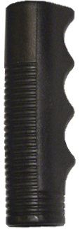
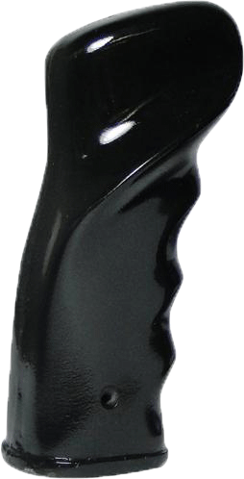
Animation of a Sailplane Landing Gear Warning System
Phase 1: Take Off
Landing Gear Down
Airbrakes Closed
Airbrake Control Lever
Phase 2: Airborne
Landing Gear Up
Airbrakes Closed
Phase 3: Landing
Landing Gear Up!
Airbrakes Open!
Alarm Sounds!
Phase 4: Landing
Landing Gear Down
Airbrakes Open
AIRBRAKES OPEN!!
Airbrakes Open
Airbrakes Closed
⬅ Open
Magnet
Closed ➔
Air Brake Switch
N.C. Magnetic Switch
Click to Sequence Animation
Power (+)
Power (+)
Power (+)
Switch Off
Animation is shown using normally closed (N.C.) magnetic switches
Switch On
Alarm
Horn
Alarm
Horn
LANDING GEAR UP!!
Gear Control Lever
Gear Control Lever
Landing Gear Down
+
⬅ Up
Down ➔
Down ➔
_
ALARM!
Magnet
Magnet
Landing Gear Switch
N.C.
Magnetic Switch
Ground (-)
Power (+)
Power (+)
Battery
Switch Off
Switch On
Armed!
Notes:
Add “No Power”?

Slide 17
DO NOT REMOVE THIS SLIDE!
Important Animation Transition Slide!

Slide 18
Landing Gear Up
Landing Gear Down
Airbrake Control Lever
Magnet
Closed ➔
Gear Control Lever
Gear Control Lever
Magnet
Down ➔
Magnet
Down ➔
Airbrakes Open
Airbrakes Closed
Airbrakes Open

Slide 19
Click Here to
Repeat
Animation
Click Here to
Learn
More

Slide 20
LANDING GEAR WARNING SYSTEM HARDWARE DEVICES

Slide 21
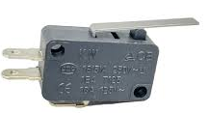

Landing Gear Warning System Hardware
There are Typically Two Types of Switches Used in Gear Warning Systems
  Mechanical (Micro) switches
  Magnetic switches
Magnetic switches are preferred because;
  Safety – To activate the magnetic switch the magnet does not need to touch each other. Thus, by not touching control linkages reduces the possible of linkage interference/damage and/or switch damage
  Nearly any magnet, large or small, will work to activate the magnetic switch
  The magnetic switch will last through many more millions of on/off cycles versus a mechanical switch
  The magnetic switch can be easily mounted (typically epoxied in place)
  The magnet can be mounted in various ways;
    Steel linkages: the magnet will attach itself (permanently glue later)
    Aluminum linkages: taped in place for testing (permanently glue later)
    Either mounting method allows for easily movement of the magnets to test the warning system’s functionality
* See https://www.youtube.com/watch?v=R--m0NDR0j8&t=338s for an aviation related safety take on the use of mechanical micro-switches.

Slide 22
Landing Gear Warning System Hardware
There are Two General Types of Magnetic Switches
Magnetic “Reed”
Magnetic “Hall-Effect”
  Magnetic “Reed” Switches
    This is an electro-mechanical switch
    Uses a pair of magnetizable, flexible, metal reeds whose end portions are separated by a small gap
    https://en.wikipedia.org/wiki/Reed_switch
  Magnetic “Hall-Effect” Switches (Sensors)
    Requires power to work
    Less prone to mechanical failure due to no wear on physical parts
    https://en.wikipedia.org/wiki/Hall_effect_sensor

Slide 23
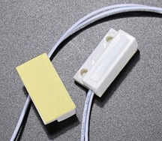
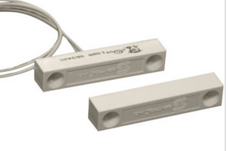
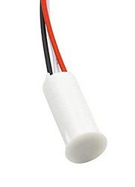
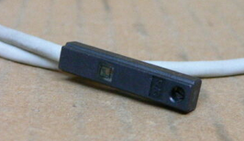

Landing Gear Warning System Hardware
Examples of Various Common Magnetic (Reed) Switches
See https://en.wikipedia.org/wiki/Reed_switch
Most Basic Type (Glass Enclosed)

Slide 24

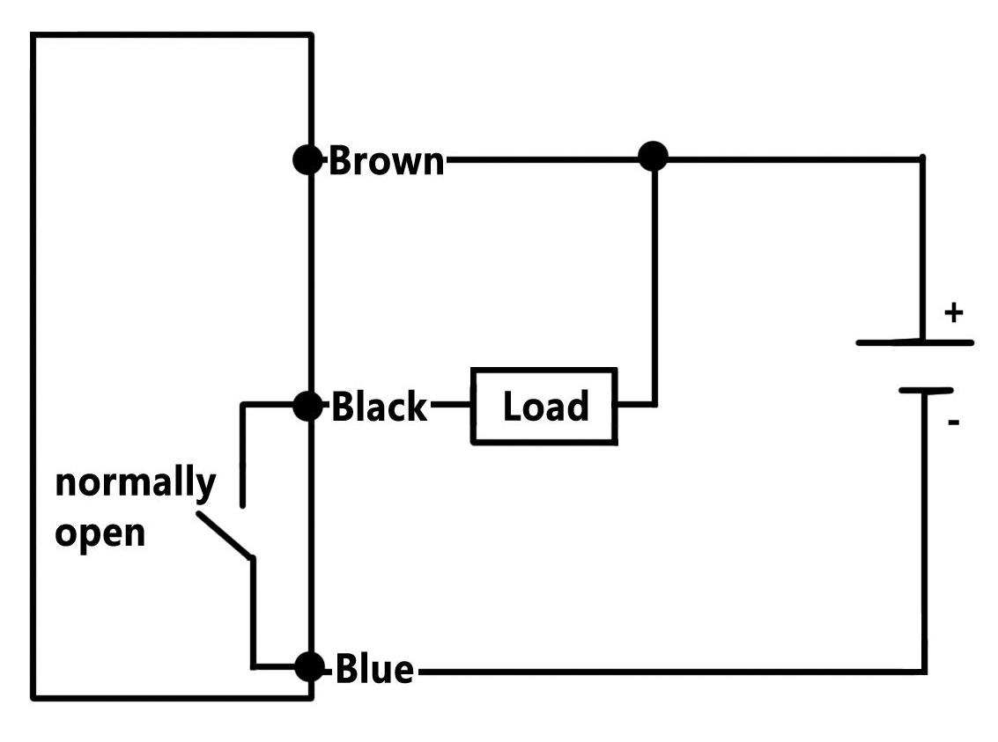

Landing Gear Warning System Hardware
Examples of Various Common Magnetic “Hall-Effect” Switches
Another Type of Magnetic Switch
  Another type of magnetic switch is known as a “Hall Effect Sensor”.
  It works similar to the previously mentioned “Reed” switch by being activated by a nearby magnet. An advantage is that the the hall effect sensor has no moving parts.
  Mounting of this sensor may be different than the “Reed” types.
  Wiring of this sensor will be different as shown in the sample diagram.
  See https://en.wikipedia.org/wiki/Hall_effect_sensor for details.
Sample Circuit
See https://en.wikipedia.org/wiki/Hall_effect_sensor

Slide 25
Landing Gear Warning System Hardware
There are Two Common Types of Switch Contacts
  Normally Open (N.O.) Magnetic Switch
    When a magnetic N.O. switch is near a magnet, electricity will flow through the wires (turned on)
    When a magnetic N.O. switch is not near a magnet, electricity will not flow through the wires. (turned off)
  Normally Closed (N.C.) Magnetic Switch
    When a magnetic N.C. switch is near a magnet, electricity will not flow through the wires. (turned off)
    When a magnetic N.C. switch is not near a magnet, electricity will flow through the wires. (turned on)
Magnetic “Reed” Switch
Magnetic “Hall-Effect” Switch
For Gear Warning systems two switches will be required (air brake and landing gear). For your particular glider’s situation you may need one of each type of switch, or two switches of a particular type.

Slide 26
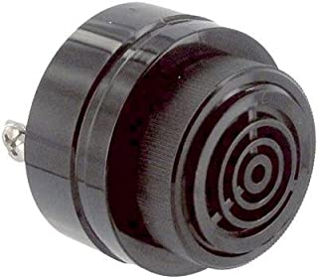
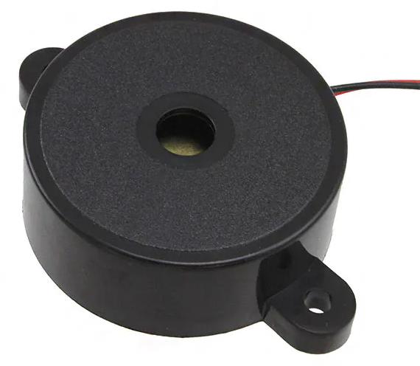
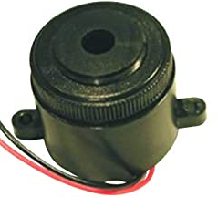
Landing Gear Warning System Hardware
Alarm Horn, Wiring & Switches
  Alarm Horn
    There are many 12Vdc alarm piezoelectric horns available on the internet.
    Get an alarm that is LOUD! The Mallory Sonalert brand of audible alarms is the best IMHO.
    Amazon link to Mallory Sonalerts ➔ https://www.amazon.com/s?k=sonalert
    Typical mounting position of the horn is hidden behind the instrument panel.
  Wiring & Battery Connections
    Use only Tefzel type wiring
    See http://aviation.derosaweb.net/presentations/#wiring for more details.
  Magnetic Switches
    Secure mounting of the magnetic switch and magnet is critical.
    A high quality epoxy is the best option. West Systems brand is recommended.

Slide 27
IMPLEMENTATION OF A LANDING GEAR WARNING SYSTEM

Slide 28
IMPLEMENTING A LANDING GEAR WARNING SYSTEM
Becoming Familiar with How the Gear Warning System Works
  Temporarily connect the magnetic switches to a battery and the alarm horn* as shown in the simple wiring diagram below
  Move magnets near/away from the magnetic switches to turn them on/off and see how this turns on/off the alarm horn.
Power
Airbrake Switch
Alarm
Horn
_
Power
ALARM!
Landing Gear Switch
+
Ground
Power
Battery

Slide 29
IMPLEMENTING A LANDING GEAR WARNING SYSTEM
Trial Installation of the Gear Warning System
  Gain access to the gear and airbrake linkages by removing access panels as needed. Typically, these locations are nearest to the handles of the airbrake and gear levers along the sides of the cockpit.
  Determine how the gear and airbrake linkages move as the handles are push/pulled. The portion moving is where the magnets should be temporarily mounted* so that they move back and forth on the linkage and will actuate/deactivate a nearby magnetic switch.
  Temporarily mount* the magnetic switches so that when the handles+magnets move they come close enough to the magnetic switch to activate it (within appox. 1/8” or 3mm).
    You may find that a more powerful rare-earth magnet is needed in your particular glider
  Temporarily wire the switches to the battery and alarm horn per the previous slide.
* Double sided tape should work well during testing

Slide 30
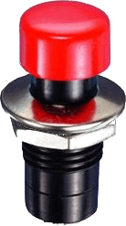
TESTTING A LANDING GEAR WARNING SYSTEM
Adding a Landing Gear Alarm Test Button
  It is always best to test the system by opening the airbrakes while cycling the landing gear. However, you may want to add a momentary type test button that bypasses both of the magnetic switches for testing purposes.
Power
Airbrake Switch
Alarm
Horn
Momentary
Test Button
_
ALARM!
Landing Gear Switch
+
Ground
Power
Battery

Slide 31
TESTING A LANDING GEAR WARNING SYSTEM

Slide 32
IMPLEMENTING A LANDING GEAR WARNING SYSTEM
Testing the Trial Gear Warning System
  Place the fuselage on a cradle to allow the gear to be easily raised and lowered
  Fully assemble the glider (wings, etc) for correct linkage movement
  Test sequence;
    Lower the gear and move the airbrakes to both open & closed positions The alarm horn should not sound
    Raise the gear and close the airbrakes The alarm horn should not sound
    Raise the gear and open the airbrakes The alarm horn MUST SOUND
  Adjustments if needed
    Type of switched used (normally open or normally closed)
    Wiring of switches to the battery and/or alarm horn.
    Positions of the switches and/or magnets
    Retest until correct.

Slide 33
Flow Chart for Testing
A Gear Warning System
Gear
Status?
Down
Up
Gear Up AND Airbrake Open??
YES!
NO
START
Here
NO ALARM!
ALARM!
Air Brake Status?
Closed
Open
ALARM!

Slide 34
Click Here to
Repeat
Animation
Click Here to
End
Presentation

Slide 35
See My Other Presentations
Glider Electrical Wiring
Transceiver Troubleshooting
Oxygen Systems
Working with Glider Air Lines
Trailer Wiring & LED Lighting
Trailer Chains
Soaring Pilot Relief Systems
Battery Testing
Emergency Location Devices
Survival Kits
Spar Alignment Tool
L’Hotellier Fittings
Carbon Fiber Panels
IGC Filename Decoding
Blanik L-23 Strut Work
Removing Painted Lettering
Open Glider Network
Instrument Knob Extensions
Landing Gear Warning Systems
http://aviation.derosaweb.net/presentations
Let me know of any comments!

