Slide 1

FLARM Device Configuration & Registration
Chicagoland Glider Council Presentation Series
By John DeRosa
Issue Date: March 9, 2026
Notes:
Opening page. Introduce yourself. Electrical engineer and computer science guy
Own a DG-101G ELAN
Welcome the audience.
Thank Paul Remde of Cumulus Soaring
Happy to know that there are lots of pictures.

Slide 2
To be added/corrected/changed
Glidernet.org clear database commands ???

Slide 3
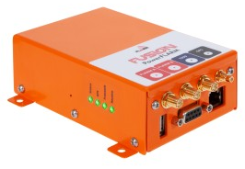
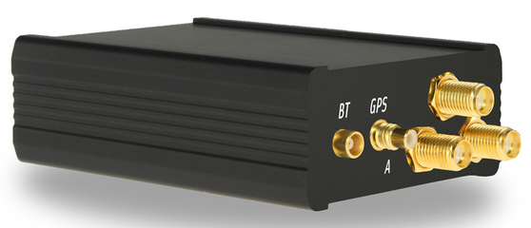
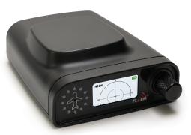
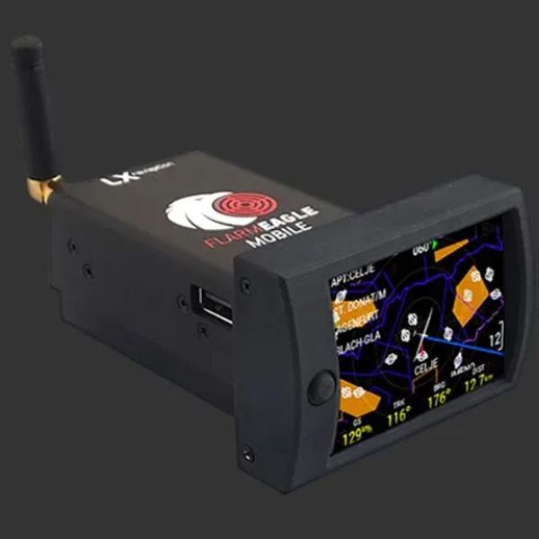
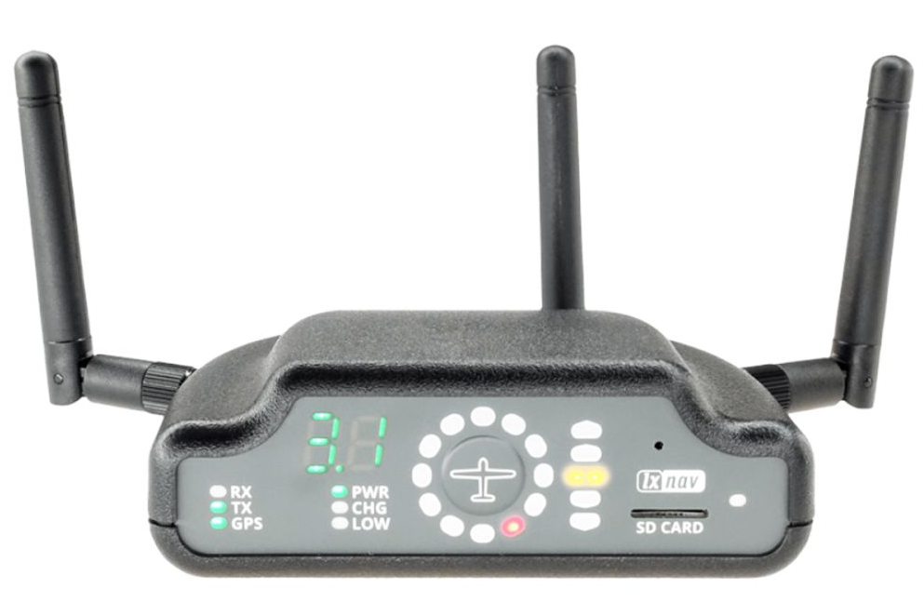
LXNAV-PowerMouse
PowerFLARM Fusion
LXNav PowerFLARM Flex
LX Navigation PowerFlarm Eagle
LXNAV FlarmBat

Slide 4
PLEASE NOTE
This presentation may have been recently updated with new information, changes, and/or corrections.
Be sure to visit my presentation web site and download the latest version of this document.
It could make an important difference with your work!
http://aviation.derosaweb.net/presentations
Thank you, John (OHM Ω)

Slide 5
Basic FLARM Device Information
FLARM is a portmanteau of “FLight" and “ALarm"
Flarm is a proprietary electronic system used to selectively alert pilots to potential collisions between aircraft. It is not formally an implementation of ADS-B, as it is optimized for the specific needs of light aircraft, not for long-range communication or ATC interaction.
The installation of all physical Flarm Devices is approved as a "Standard Change", and the PowerFLARM Core specifically as a "Minor Change" by the European Union Aviation Safety Agency; and in addition the Minor Change also approves the PowerFLARM Core for its IFR and at night.
Flarm obtains its position and altitude readings from an internal GPS and then broadcasts this together with forecast data about the future 3D flight track. At the same time, its receiver listens for other FLARM Devices within range and processes the information received.
This information is used to predict potential conflicts for other aircraft and alert the pilot using visual and aural warnings.
Source: https://en.wikipedia.org/wiki/FLARM

Slide 6
Why is This Presentation
Important?
The work detailed in this presentation is very important to the proper operation of your FLARM Device. It is not simply enough to physically install your Flarm and antennas.
Three things must happen;
The FLARM device must be configured.
To make your Flarm valuable to those other pilots flying with, or near you, you also need to register your unique FLARM Device.
Keep your FLARM device updated yearly.
PS – Sorry, this presentation does NOT show you how to install a FLARM Device into your aircraft.

Slide 7
Table of Contents
FLARM Device Information
Why is this Presentation Important?
“FLARM” versus “Flarm”
FLARM Hardware Requirements
Flarm Transmission & Reception Animation
Configuration Steps
  FLARM Configuration File
  Registering Your FLARM
  FlarmNet Database File
  Flarm Glidernet File
  FLARM Registration With OGN
FLARM Display Devices
Miscellaneous How-To Details
  FLARM Range Analysis
  Transferring a FLARM device to a new owner
Miscellaneous Flarm Information

Slide 8

Meaning of
“FLARM” versus “Flarm”
Use Within this Document
“Flarm” (initial capitals only)
  This will refer to the Flarm system as a whole or parts thereof
“FLARM” (all capitals)
  This refers to the physical FLARM devices.

Slide 9
How does Flarm
Transmission & Reception Work?
An Animation
  The following few slides shows an “animation” of the step-by-step process of how the Flarm system communicates between two aircraft (gliders).
  Step through the slides one at a time
  or download & run the PowerPoint File
  from the web site for more clarity
Watch the Following Animation

Slide 10


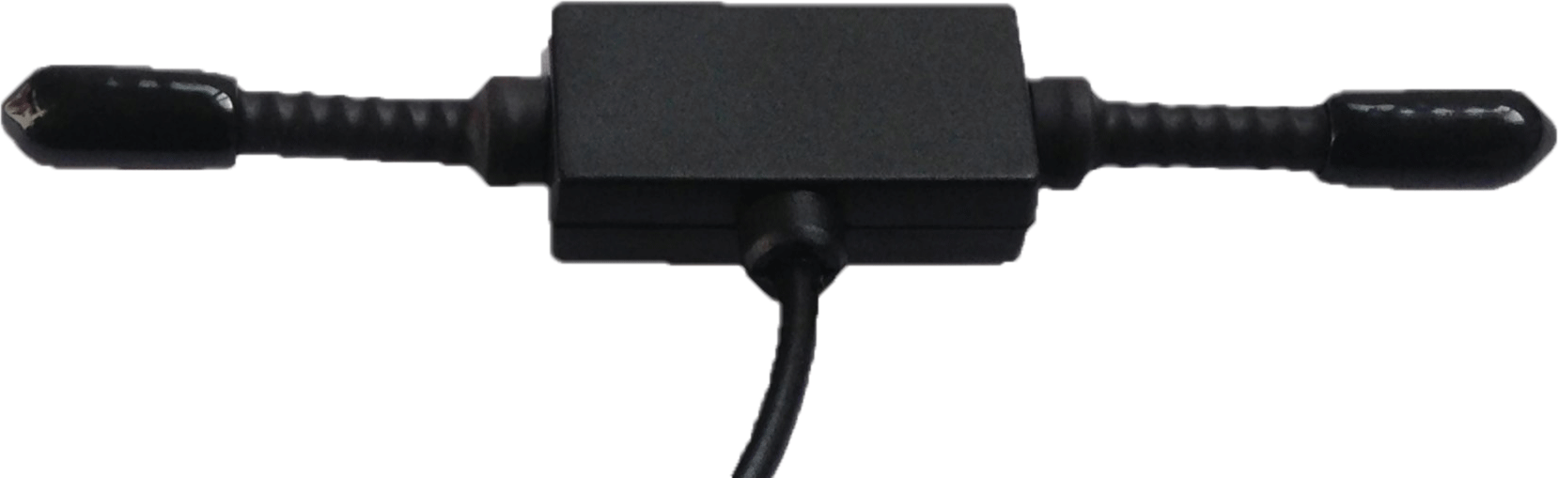
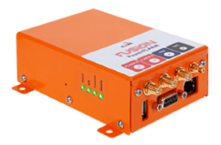


Step 1 – Glider BLU’s FLARM
broadcasts its information
Glider “BLU”
Step 1b - Glider BLU’s FLARM continuously broadcasts
its unique Radio-ID* and its GPS position details
FLARM
Config
File
NOTE - NO pilot info is sent! (e.g. Name, Contest ID, N#, etc.)
Step 1a - Glider BLU’s unique Radio-ID* is in the configuration file (among other things detailed in another slide)
Glider “BRN”
* The recommended FLARM’s “Radio-ID” is the aircraft’s unique 6-digit ICAO number or “Mode S Code”. See details at “https://registry.faa.gov/aircraftinquiry/search/nnumberinquiry

Slide 11
Step 2 – Glider BRN’s FLARM
Receives “BLU’s Flarm Data
Glider “BLU”
Step 1b - Glider BLU’s FLARM continuously broadcasts
its unique Radio-ID* and its GPS position details
FLARM
Config
File
NOTE - NO pilot info is sent! (e.g. Name, Contest ID, N#, etc.)
Step 2 - Glider BRN’s FLARM listens & receives
Glider BLU’s Flarm data including its unique Radio-ID* and GPS position details
Step 1a - Glider BLU’s unique Radio-ID* is in the configuration file (among other things detailed in another slide)
Glider “BRN”
* The recommended FLARM’s “Radio-ID” is the aircraft’s unique 6-digit ICAO number or “Mode S Code”. See details at https://registry.faa.gov/aircraftinquiry/search/nnumberinquiry

Slide 12
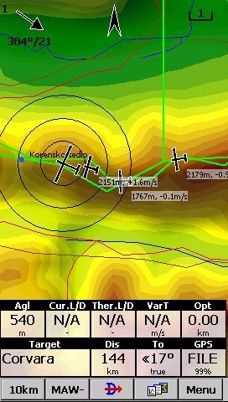
Step 3 – Glider BRN’s FLARM sends Glider BLU’s info to a Display Device
Glider “BLU”
Step 1b - Glider BLU’s FLARM continuously broadcasts
its unique Radio-ID* and its GPS position details
FLARM
Config
File
NOTE - NO pilot info is sent! (e.g. Name, Contest ID, N#, etc.)
Step 2 - Glider BRN’s FLARM listens & receives
Glider BLU’s Flarm data including its unique Radio-ID* and GPS position details
123XYZ
Step 1a - Glider BLU’s unique Radio-ID* is in the configuration file (among other things detailed in another slide)
Glider “BRN”
Step 3 - Glider BRN’s FLARM sends Glider BLU’s Flarm data of Radio-ID* and
GPS position details to your Flarm Display Device
(i.e. an Oudie) which
then displays a target.
* The recommended FLARM’s “Radio-ID” is the aircraft’s unique 6-digit ICAO number or “Mode S Code”. See details at https://registry.faa.gov/aircraftinquiry/search/nnumberinquiry

Slide 13
Step 4 – Glider BRN’s display device uses FlarmNet Database
Step 4 - Glider BRN’s Display Device looks into it’s FlarmNet database file for Glider BLU’s Radio-ID* (123XYZ) is Glider BLU and shows “BLU” on the Flarm display device’s screen.
Glider “BLU”
Step 1b - Glider BLU’s FLARM continuously broadcasts
its unique Radio-ID* and its GPS position details
FlarmNet
Database File >
“123XYZ”
”BLU”
BLU
FLARM
Config
File
NOTE - NO pilot info is sent! (e.g. Name, Contest ID, N#, etc.)
Step 2 - Glider BRN’s FLARM listens & receives
Glider BLU’s Flarm data including its unique Radio-ID* and GPS position details
123XYZ
Step 1a - Glider BLU’s unique Radio-ID* is in the configuration file (among other things detailed in an other slide)
Glider “BRN”
Step 3 - Glider BRN’s FLARM sends Glider BLU’s Flarm data of Radio-ID* and
GPS position details to your Flarm Display Device
(i.e. an Oudie) which
then displays a target.
* The recommended FLARM’s “Radio-ID” is the aircraft’s unique 6-digit ICAO number or “Mode S Code”. See details at https://registry.faa.gov/aircraftinquiry/search/nnumberinquiry

Slide 14
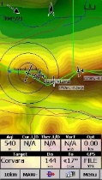
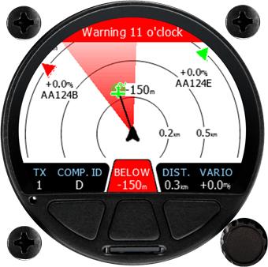
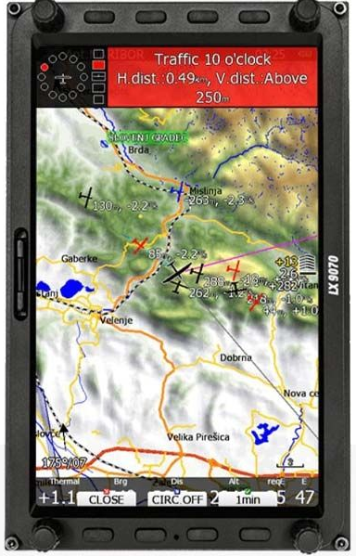
All Flarm Data “Packet” Elements
Sent Between the FLARM Device
and the Flarm Display Device
<ID>
<IDType>
<AlarmLevel>
<RelativeNorth>
<RelativeEast>,
<RelativeVertical>
<Track>
<TurnRate>
<GroundSpeed>,
<ClimbRate>
<AcftType>
Source: Moshe Braner

Slide 15
CRITICAL FIRST STEPS
Creation & Installation of …
> FLARM Configuration File
> FlarmNet Database File
FlarmNet
Database File
Glider “BLU”
FLARM
Config
File

Slide 16
FLARM Setup Requirements
You will need three things;
  A FLARM Device ➔
  Your Contest ID
  Your Radio ID*
  A Flarm traffic Display Device ➔
Steps you will need to take;
  Create a configuration file & download it to your FLARM Device
  Register your FLARM Device on FlarmNet
  Download the latest global FlarmNet user database to your Flarm Display Device
  Register your FLARM Device on GliderNet (OGN)
*The recommended FLARM Radio-ID is the 6-digit hexadecimal ICAO address of
your aircraft (also known as Mode S Code). In the USA look up the ICAO number for your aircraft at https://registry.faa.gov/aircraftinquiry/search/nnumberinquiry

Slide 17
STEP 1
Creating and Downloading a
FLARM Configuration File
Your FLARM device cannot operate properly without a configuration file for your glider. It is very important that the device configured correctly.
Use the flarm configuration tool to configure your Device. After selecting the desired options, the configuration file is downloaded and installed
into your FLARM Device.

Slide 18
FLARM Configuration File
When installing FLARM in an aircraft, and before using a FLARM Device, it is very important that it is configured correctly.
Use the flarm configuration tool to create a flarmcfg.text file. After selecting the desired options, the configuration file is quickly downloaded to your FLARM device.
Use the FLARM Device
Configuration File Creation Tool found at
https://www.flarm.com/en/support/tools-software/configurator/
Continued on Next Slide

Slide 19
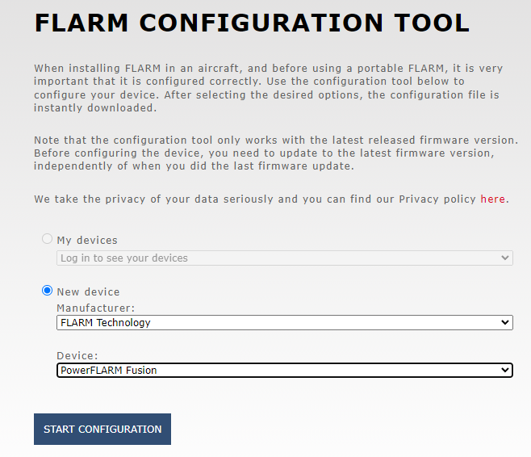

FLARM Configuration File
From Previous Slide
Enter your FLARM Device manufacturer and model
CLICK ON
Continued on Next Slide

Slide 20
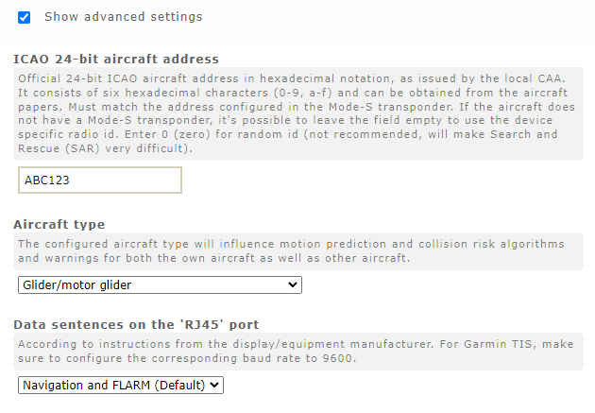

FLARM Configuration File
From Previous Slide
CLICK ON
Enter your ship’s Mode-S ICAO* Address
Enter your ship’s Aircraft Type
* In the USA look up your “Mode S” Address at https://registry.faa.gov/aircraftinquiry/search/nnumberinquiry
NOTE: Normally other settings can be left as the default values.
Continued on Next Slide

Slide 21
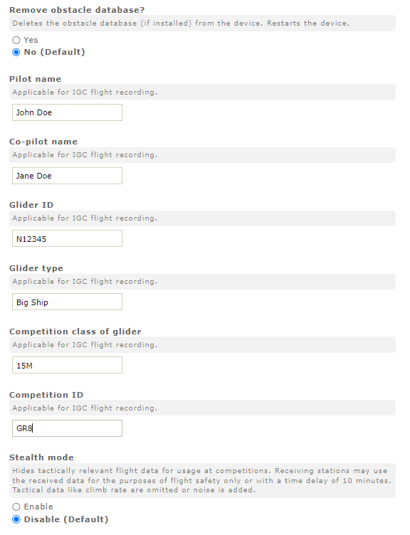
FLARM Configuration File
From Previous Slide
NOTE: Other Flarm settings normally can be left as the default values.
Enter your Name, Tail Number, Contest ID, etc. (NOTE: This information is NOT broadcast by the FLARM. It is
ONLY USED within the
IGC flight log file
created by the
FLARM device)
NOTE: This
information
is NOT
broadcasted
by the
FLARM Device.
It is ONLY USED
within the
IGC flight log
file created
by the
FLARM device.
Continued on Next Slide
NOTE: Other Flarm settings normally can be left as the default values.

Slide 22

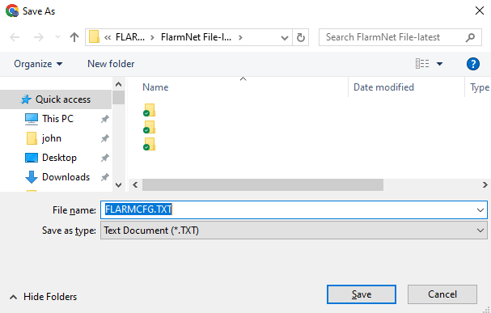

FLARM Configuration File
From Previous Slide
CLICK ON
Save the FLARM configuration file to your computer
CLICK ON
Continued on Next Slide
flarmcfg.text

Slide 23
FLARM Configuration File
From Previous Slide
Transfer the Flarm configuration file into your FLARM Device
per the manufacturer’s instructions.*
flarmcfg.text
Typically, this is done by copying the flarmcfg.text file to a USB “thumb” drive or micro SD card.
Then plug that drive into your FLARM device and turn on power to the device.

Slide 24
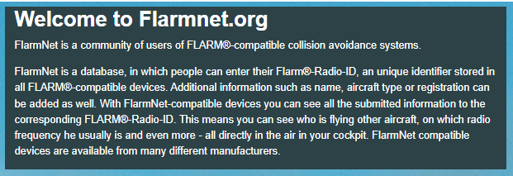
STEP 2
Registering Your FLARM Device
At FlarmNet.org
Source: http://flarmnet.org

Slide 25
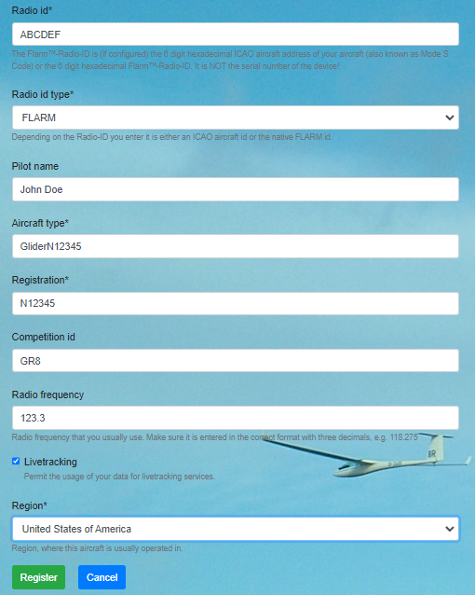
Flarmnet Registration
Enter the ”Radio ID”* and other information for your FLARM Device at
http://flarmnet.org
*
CLICK ON
Your FLARM Device has now been added to the flarmnet.org
Global Database
Which links your
”Radio ID”* (only) to your Contest ID
*The recommended FLARM Radio-ID is the 6-digit hexadecimal ICAO address of your aircraft
(also known as Mode S Code).
In the USA look up the ICAO number for your aircraft at https://registry.faa.gov/aircraftinquiry/search/nnumberinquiry

Slide 26
STEP 3
Download and Install the Latest FlarmNet Database
The FlarmNet database contains a listing of all registered FLARM Devices and their associated information primarily ICAO & Contest ID.
Transfer the latest database to your FLARM display device so that this information (i.e. Contest ID) can be displayed next to the aircraft’s icon on your display device.

Slide 27
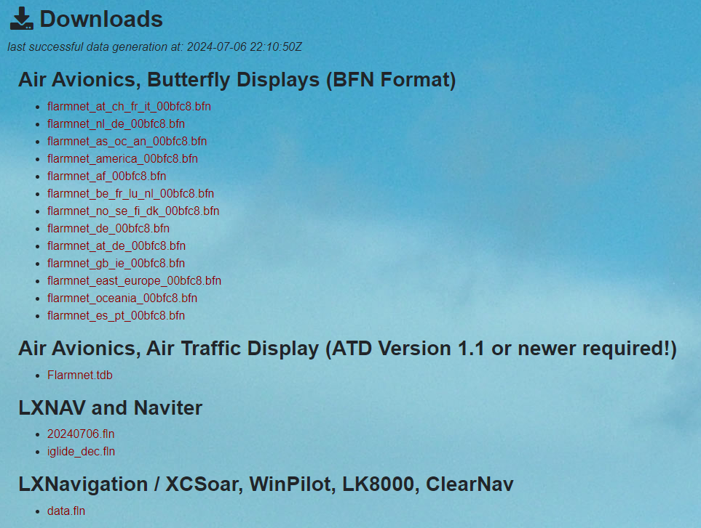
FlarmNet Database File
Download/save to your computer the appropriate FlarmNet global database file for your particular FLARM Display Device from https://www.flarmnet.org/flarmnet/downloads/*
BLU
Transfer the new FlarmNet database file into pilot’s display Devices using the manufacturer’s instructions.
This allows viewing of flarm traffic’s information (i.e.Contest IDs)
on their displays *
BLU
[date].fln
data.fln
etc.
BLU
* The FlarmNet database file is updated daily and should be
re-downloaded and re-installed yearly or more often.

Slide 28
Step 4 - Glidernet - The OGN Database
Is Now Accepting FLARM Registrations
There is an independent database at http://ddb.glidernet.org that is related to the OGN environment. Besides accepting OGN devices registrations it also accepts FLARM device registrations.
Note that the OGN (glidernet) database is not limited to Flarms, it includes other registered devices or aircraft IDs that may be broadcast by transponders, SPOT/Inreach, phone apps, etc. Sanity prevails as long as all devices in an aircraft use the same Radio-ID (ICAO number*).
Some people register with either the ddb.glidernet.org site, flarmnet.org site, or both. The two databases can even hold conflicting information about the same Radio-ID. One can also create their own personal data file based on information from both of those databases plus local observations.
Use http://ddb.glidernet.org/download to download that database as a text file.
Source: Moshe Braner
*The recommended FLARM Radio-ID is the 6-digit hexadecimal ICAO address of your aircraft (also known as Mode S Code). In the USA look up the ICAO number for your aircraft at https://registry.faa.gov/aircraftinquiry/search/nnumberinquiry

Slide 29
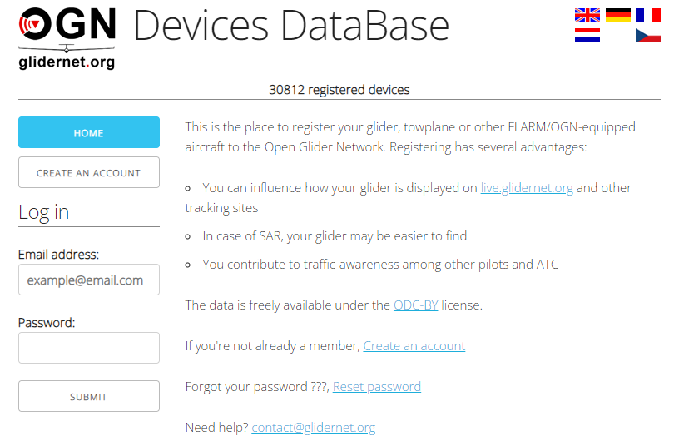
STEP 4
Register Your FLARM Device
At ddb.glidernet.org
Source: http://ddb.glidernet.org

Slide 30

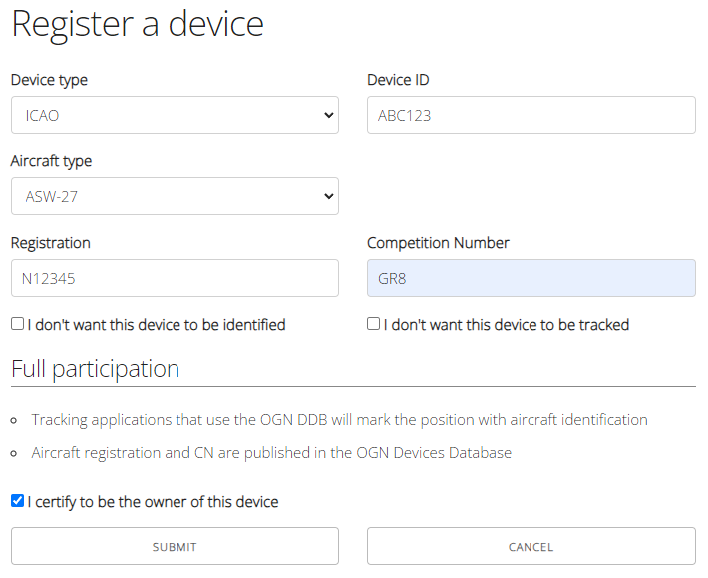

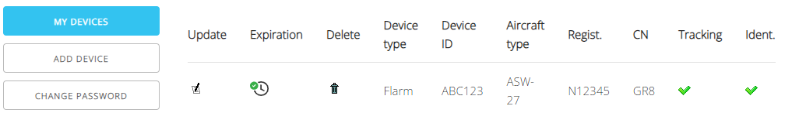
Glidernet Registration
Log in at http://ddb.glidernet.org
CLICK ON
Enter Device Type as ICAO, enter the Device ID”*, and other aircraft information
*
Your FLARM Device has been added to the ddb.glidernet.org
Global Database
Which links your
”Device ID”* to your Contest ID
CLICK ON
Database Search
http://wiki.glidernet.org/ddb-list
*The recommended Device ID (a.k.a Radio-ID) is the 6-digit hexadecimal ICAO address of your aircraft (also known as Mode S Code). In the USA look up the ICAO number for your aircraft at https://registry.faa.gov/aircraftinquiry/search/nnumberinquiry

Slide 31

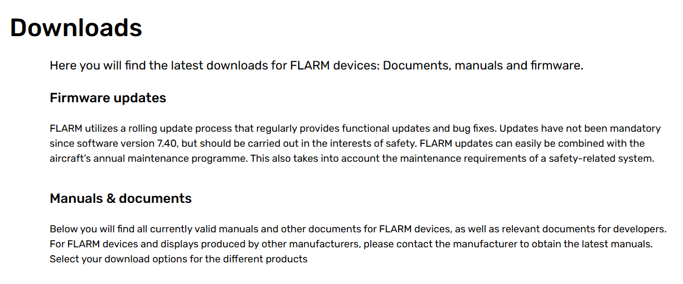
FLARM Software Updating
Flarm.com
Each Flarm Device must have its software updates annually.
www.flarm.com/en/support/downloads/

Slide 32
FLARM Display Devices
Now your FLARM Device is configured and registered. You will see all other FLARM equipped aircraft (and ADS-B traffic). Other pilots with
a FLARM device and a configured database will see your aircraft
information (i.e. contest ID). This provides critical
collision avoidance even when the contest ID is not displayed.
BLU
BLU
BLU

Slide 33
Miscellaneous
Flarm
Information

Slide 34
FLARM Device Range Analysis
https://www.flarm.com/en/support/tools-software/range-analysis/
https://gliding.lxnav.com/flarm-range/

Slide 35

Miscellaneous HOW TO…
Transferring the Ownership of a FLARM Device
Transferring your FLARM Device to a New Aircraft

Slide 36
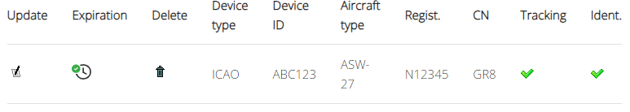
Transfer a Glidernet registered FLARM Device to a New Owner
Method #1
Method #2
Method #3
Contact the previous owner
Ask them to Log into their account on ddb.glidernet.org
Have them go to “My Devices”
Look for the correct FLARM device and click on the trash can symbol to delete it
Re-register your FLARM device as shown in this presentation
IGC file proof of ownership. See the next slide for details.
All Glidernet registrations expire after one (1) year
Once the registration expires re-register your FLARM device as shown in this presentation

Slide 37
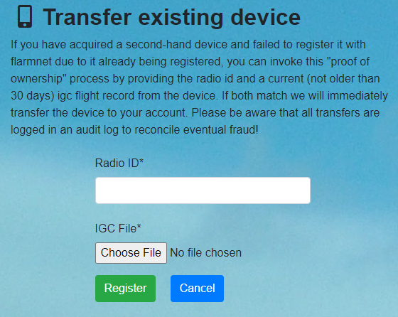
Transfer a Flarmnet registered FLARM Device to a New Owner
https://www.flarmnet.org/flarmnet/device/transfer/
Retrieve a recent IGC log file from your newly purchased used FLARM device
Open the IGC file with a text editor
Look for this line near the beginning of the file > “LFLA192557ID 1 xxxxxx”
The last 6 digits (xxxxxx) is the Radio ID
Enter the Radio ID here
Choose (upload) the same IGC file
you used to find the Radio ID
Click on Register

Slide 38
Transferring a FLARM Device into another Aircraft
Be sure to create a new flarmcfg.txt file with the new aircraft’s ICAO* number per the instructions at the top of this presentation.
*In the USA look up the ICAO number for your aircraft at https://registry.faa.gov/aircraftinquiry/search/nnumberinquiry

Slide 39
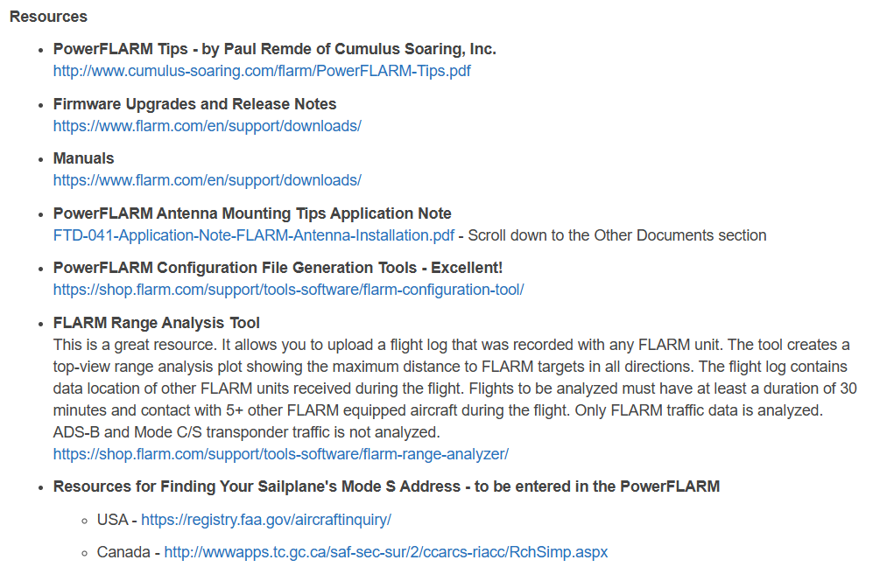
Flarm Informational Web Sites
https://www.cumulus-soaring.com/store/manufacturers/flarm

Slide 40
Flarm Informational Web Sites
https://nadler.com/GliderPilotUSAflarmWeb/Flarm-WhatDoesItDo.html
https://www.flarm.com/en/
https://www.flarm.com/en/support/faq/
https://www.flarmnet.org/faq
https://en.wikipedia.org/wiki/FLARM
http://www.cumulus-soaring.com/flarm/PowerFLARM-Tips.pdf

Slide 41
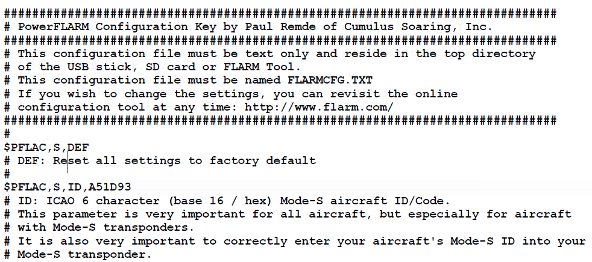
FLARM Configuration File (flarmcfg.txt)
Command Options with Details
Source: http://www.cumulus-soaring.com/flarm/PowerFLARM-Tips.pdf

Slide 42
FLARM flarmcfg.text
File to Reset Flarm Device
To Factory Settings
###########################################################
# This configuration file must be text only and reside in the top directory
# of the USB stick, SD card or FLARM Tool.
# This configuration file must be named FLARMCFG.TXT
# If you wish to change the settings, you can revisit the online
# configuration tool at any time: http://www.flarm.com/
###########################################################
$PFLAC,S,DEF

Slide 43
Sample Flarm Information found in an
IGC Flight Log File– Page 1/2
LFLA19255707FRW 7.24
LFLA192557 STEALTH OFF
LFLA192557 NOTRACK OFF
LFLA192557ID 1 A1FB1D
LFLA192557OB
LFLA19255707OBSTEXP
LFLA19255707DEVNO FLAFUS10W-000790
LFLA19255707BUILD ab6c756fe
LFLA19255707RANGE 25500
LFLA19255707ACFT 1
LFLA19255707THRE 255
LFLA19255707CFLAGS 00
LFLA19255707RFTX 1
LFLA19255707MISC 00
LFLA19255707LOGINT 4
LFLA19255707NMEAOUT1 91
LFLA19255707BAUD1 2
LFLA19255707NMEAOUT2 1
LFLA19255707BAUD2 2
LFLA19255707VRANGE 2000

Slide 44
Sample Flarm Information found in an
IGC Flight Log File – Page 2/2
LFLA19255707PCASPFLAU1 0
LFLA19255707PCASPFLAU2 0
LFLA19255707XPDR 0
LFLA19255707PCASRANGE 7408
LFLA19255707PCASVRANGE 610
LFLA19255707ADSBRANGE 65535
LFLA19255707ADSBVRANGE 65535
LFLA19255707PCASCALIBRATION 30
LFLA19255707MODESALT 1
LFLA19255707MODEC 1
LFLA19255707PCASBEEP 1
LFLA19255707ADSBWARNINGS 1
LFLA19255707CAL57DBM 0
LFLA19255707MSG 1
LFLA19255707ADSL 1
LFLA19255707CAP DP2;USBH;XPDR;DLED;BARO;AUD;RFB;ENL;TIS;IGC;ADSR
LFLA19255707LIC AUD:1;ENL:1;IGC:1;RFB:1;TIS:1;ADSR:1

Slide 45
See My Other Presentations
Glider Electrical Wiring
Bailing Out Successfully
Transceiver Troubleshooting
Oxygen Systems
Working with Glider Air Lines
Trailer Chains
Soaring Pilot Relief Systems
Battery Testing
Emergency Location Devices
Survival Kits
Spar Alignment Tool
L’Hotellier Fittings
Carbon Fiber Panels
IGC Filename Decoding
Blanik L-23 Strut Work
Removing Painted Lettering
Open Glider Network
Instrument Knob Extensions
Landing Gear Warning
http://aviation.derosaweb.net/presentations
Let me know of any comments!

Slide 46
Questions
?
Email: jhderosa@gmail.com
Web Site: http://aviation.derosaweb.net

